Slide 1
Datacenter Network Topologies
Costin Raiciu
Advanced Topics in Distributed Systems

Slide 2
Datacenter apps have dense traffic patterns
Map-reduce jobs – shuffle phase
Mappers finish
Reducers must contact every mapper and download data
All-to-all communication!
One-to-many – scatter-gather workloads – web search, etc.
One-to-one – filesystem reads/writes

Slide 3
Flexibility is Important in Data Centers
Apps distributed across thousands of machines.
Flexibility: want any machine to be able to play any role.
But:
Traditional data center topologies are tree based.
Don’t cope well with non-local traffic patterns.

Slide 4
Traditional Data Center Topology
Core Switch
10Gbps
Aggregation Switches
10Gbps
Top of Rack
Switches
1Gbps
Racks of
servers
…

Slide 5
Problems in Traditional Solutions
They lack robustness
Aggregation switch failures wipe out entire racks
They lack performance
Oversubscription = max_throughput / worst_case_throughput
Typical oversubscription ratios 4:1, 8:1
They are expensive!
7K for 48-port Gigabit switch
700K for 128-port 10Gigabit switch

Slide 6
Want a datacenter network that:
Offers full-bisection bandwidth
Over-subscription ratio of 1:1
Worst case: every host can talk to every other host at line rate!
Is fault tolerant
Is cheap

Slide 7
The Fat Tree [Al Fares et al, Sigcomm2008]
Inspired from the telephone networks of the 50’s – Clos networks
Uses cheap, commodity switches – all switches are the same
Lots of redundancy
Single parameter to describe the topology:
K – the number of ports in a switch

Slide 8
Fat Tree Topology [Fares et al., 2008; Clos, 1953]
K=4
Aggregation Switches
K Pods with
K Switches
each
4 x 1Gbps
Racks of
servers
Notes:
Show multiple paths between servers
Say that network is rearrangeably non blocking
Clos
8

Slide 9
Fat Tree Properties
Number of hosts =
K/2 hosts per lower-pod switch
K/2 lower pod switches per pod
K pods
Full bisection
Topology is rearrangeably non-blocking

Slide 10
The Fat Tree Topology has k*k/4 paths between any two endpoints
K=4
Aggregation Switches
1Gbps
K Pods with
K Switches
each
1Gbps
Racks of
servers
Notes:
Show multiple paths between servers
Say that network is rearrangeably non blocking
Clos
10

Slide 11
Routing How do hosts access different paths?
Basic solution at Layer 2
Spanning Tree Protocol
Anything wrong with this?
Say we come up with a proper L2 solution that offers multiple paths
What about L2 broadcasts? (e.g. ARP)
Layer 2 still might be desirable, though
Some apps expect servers in the same LAN

Slide 12
Multipath Routing at Layer 3
Run a link-state routing protocol on the switches (routers) (e.g. OSPF)
Compute shortest-path to any destination
Drawback: must use smarter, more expensive switches!
Equal Cost Multipath Routing (ECMP):
When there are multiple shortest paths, pick one “randomly”
Hash packet header to choose a path
All packets of the same flow go on the same path
Why not use per-packet ECMP?

Slide 13
Novel Layer 2 solutions
TRILL – IETF standard in the making
Layer 2.5
Switches are as “Routing Bridges”
Run IS-IS between them to compute multiple paths
ECMP to place packets on different flows!
Cons: switch support still missing today

Slide 14
VL2 Topology [Greenberg et al, Sigcomm 2009]
10Gbps
10Gbps
…
20 hosts

Slide 15
Performance
ECMP routing
All-to-all traffic matrix
Every host sends to every other host – every host link is fully utilized, network runs at 100% (both VL2 and FatTree)
Many-to-one traffic: limited by the host NIC.
Permutation traffic matrix
Every host sends to/receives from a single other host a long running TCP connection
Average network utilization FatTree: 40% VL2: 80%

Slide 16
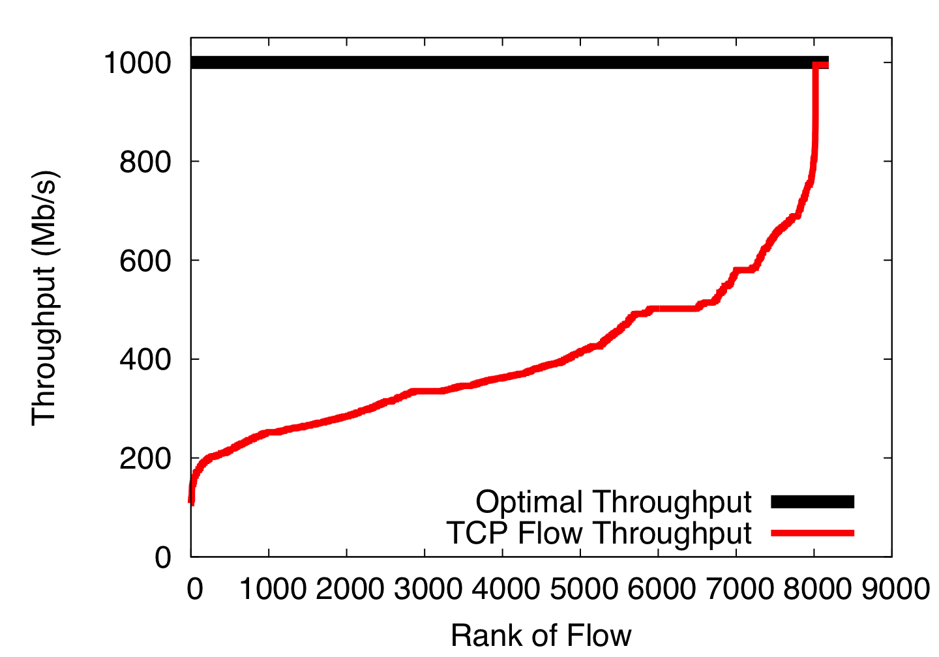
Single-path TCP collisions reduce throughput

Slide 17
Comparison between FatTree and VL2
 | FatTree | VL2
Full-bisection | Yes | Yes
Switches | Commodity | Top-end (20 Gige ports, 2 10Gige ports)
Routing | ECMP (with problems) | ECMP seems enough
Cabling | Tons of cables | Much Simpler

Slide 18
Jellyfish [Singla et. Al, NSDI 2012]

Slide 19
Incremental expansion
Facebook adding capacity “daily”
Easy to add servers, but what about the network?
Structured topologies constrain expansion
3k^2/4 servers for K-port Fat Tree
24 ports – 3456 servers
32 ports – 8192 servers
48 ports – 27648 servers
Workarounds:
Leave ports free for later or oversubscribe network

Slide 20
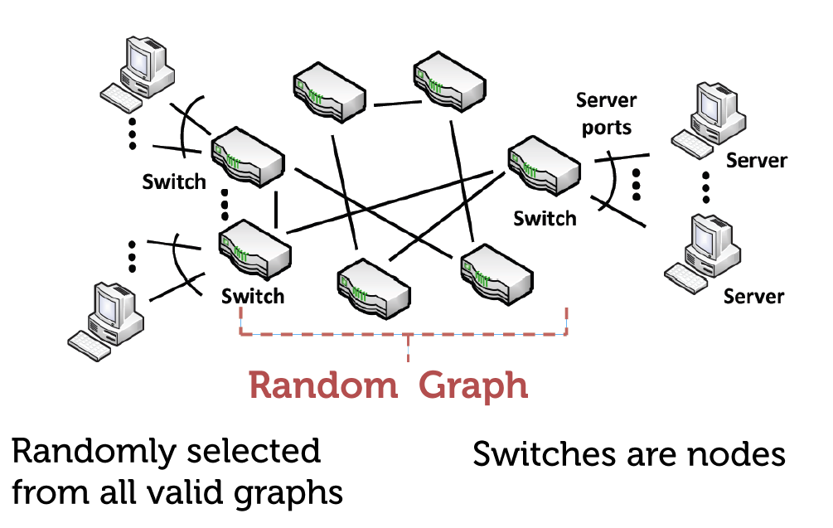
Jellyfish
Key Idea: forget about structure

Slide 21
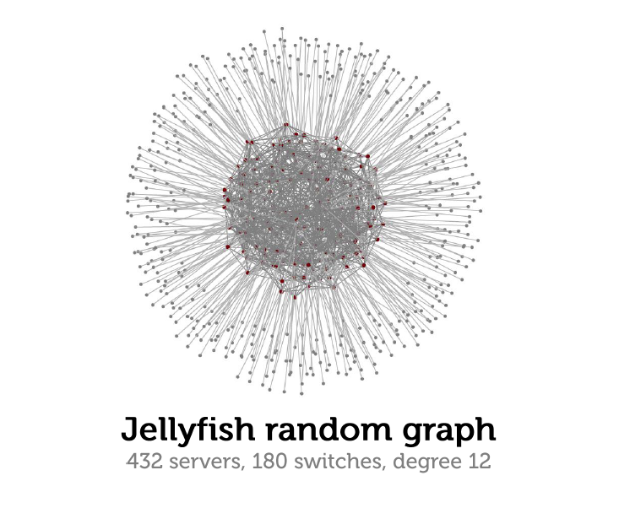
Jellyfish example

Slide 22
Jellyfish overview
Each 4L port switch connects to
L hosts
3L other random switches

Slide 23
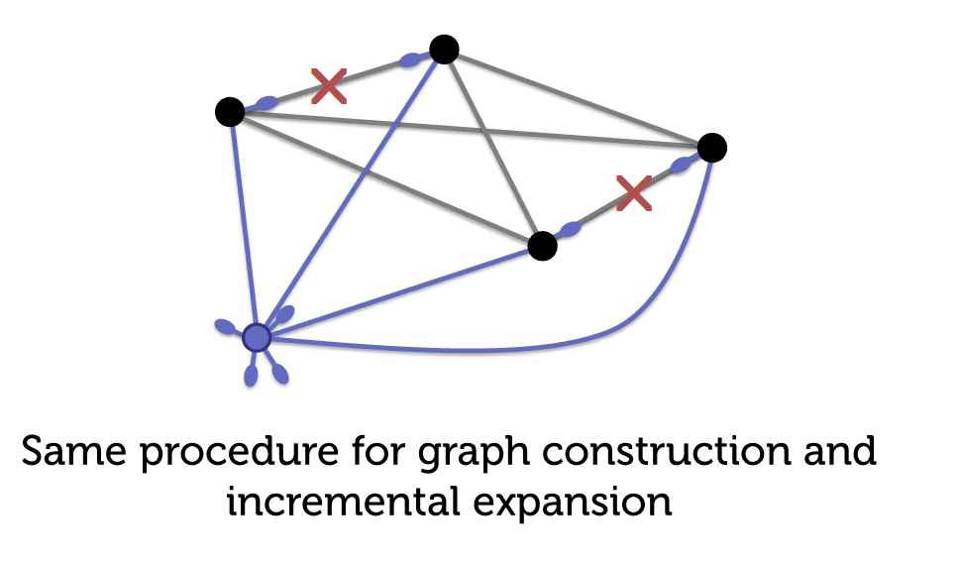
Building Jellyfish

Slide 24
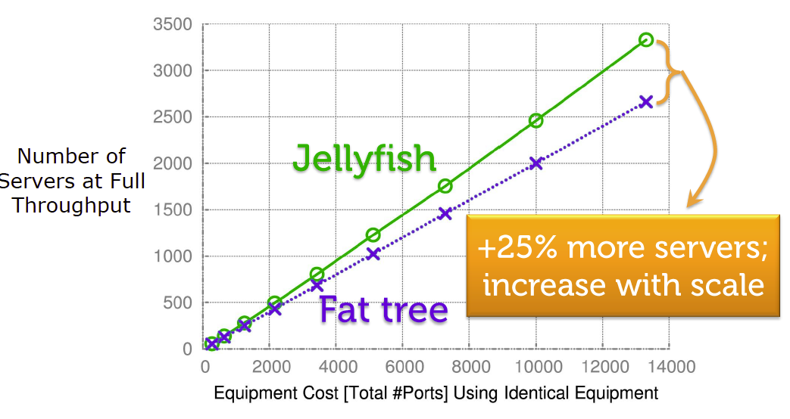
Jellyfish Performance

Slide 25
Why is Jellyfish better than FatTree?
Intuition
Say we fully utilize all available links in the network
N – number of flows getting 1Gbps throughput

Slide 26
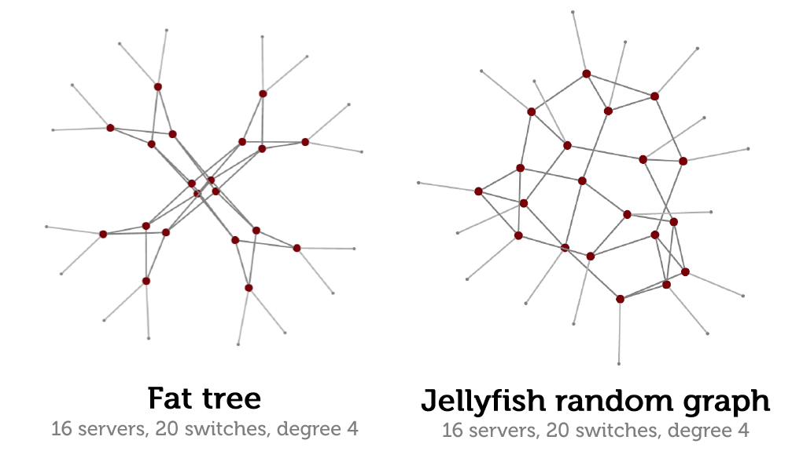
Jellyfish has smaller mean path length

Slide 27
Routing in Jellyfish
Does ECMP still work?
Use K-shortest paths instead
Much more difficult to implement!
OpenFlow (next week), Spain, MPLS-TE

Slide 28
Thinking differently: The BCube datacenter network

Slide 29
Bcube
Key Idea: Have servers forward packets on behalf of other servers
We can use very cheap, dumb switches
Bcube (n,k)
Uses n-port switches and k+1 levels
Each server has k+1 ports

Slide 30
BCube Topology [Guo et al, Sigcomm 2009]
BCube (4,0)

Slide 31
BCube Topology [Guo et al, Sigcomm 2009]
BCube (4,1)

Slide 32
BCube Topology [Guo et al, Sigcomm 2009]
BCube (4,1)

Slide 33
BCube Topology [Guo et al, Sigcomm 2009]
BCube (4,1)

Slide 34
BCube Topology [Guo et al, Sigcomm 2009]
BCube (4,1)

Slide 35
BCube Topology [Guo et al, Sigcomm 2009]
BCube (4,1)

Slide 36
BCube Properties
Number of servers: N^{K+1}
Maximum path length: K+1
K+1 parallel paths between any two servers
Is Bcube better than FatTree?
It depends on the traffic pattern
K+1 times better for many-to-one, one-to-one traffic patterns
Same as FatTree for all-to-all, permutation

Slide 37
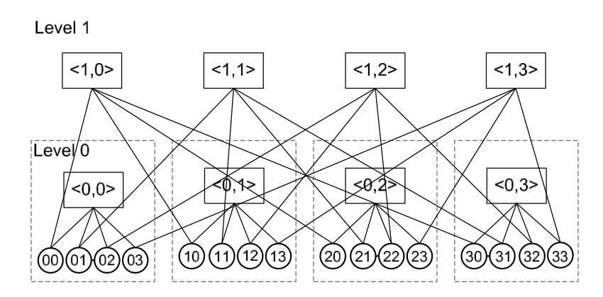
Bcube Routing

Slide 38
Issues with BCube
How do we implement routing?
Bcube source routing
How do we pick a path for each flow?
Probe all paths briefly then select best path

Slide 39
Which topologies are used in practice?

Slide 40
Which topologies are used in practice? [Raiciu et al, Hotcloud’12]
We did a brief study of the Amazon EC2 network topology (us-east-1d)
Rented many VMs
Between all pairs we ran:
Traceroute
Record route (ping –R)
Used aliasing techniques to group IPs on the same device

Slide 41
EC2 Measurement results
Edge Router (IP)
Top-of-Rack
Switch (L2)
Dom0
A
B
Dom0
C
Dom0
D

Slide 42
EC2 Measurement results
Edge Router (IP)
Top-of-Rack
Switch (L2)

Slide 43
EC2 Measurement results
Edge Router
Top-of-Rack
Switch

Slide 44
EC2 Measurement results
INTERNET
Core Router
Edge Router
Top-of-Rack
Switch
….

